Slide 1
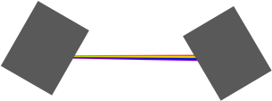
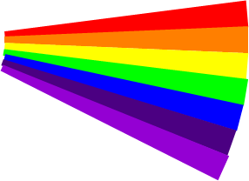
Rainbow
Shining light through a prism can make a rainbow.
The colours of a rainbow make a ‘spectrum of light’.
Light from a plain bulb
Red
Orange
Yellow
Green
Blue
Indigo
Violet

Slide 2
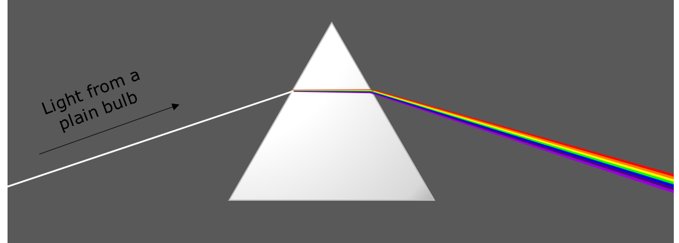
Rainbow
Where do the colours of the rainbow come from?
The prism makes the light sparkle because it is shiny
The prism adds colours to the light
The prism reacts with the light and changes its colour
The prism splits up the colours that the light is made of

